Slide 1

North Wales Dental Nurse Training Programme

Slide 2
Learning Aims & Objectives
Aims
To provide knowledge of the benefits of a pan-North Wales dental nurse training programme.
To provide an understanding of how the scheme could integrate into the workforce map
To provide a platform to discuss the issues and needs around dental nurse training in North Wales
Objectives
Improve participants’ understanding of the dental workforce landscape in North Wales
Improve participants’ understanding of innovations in dental nurse training
Improve dialogue with the profession around training and development
GDC Learning Outcomes: A, B, D

Slide 3
Background
Wide range of training pathways
Varying level of learner support from training providers
Varying levels of learner experience on completion
Learners gain experience in one clinical setting (generally)
Recruitment process for trainee dental nurse convoluted
Reduced level of interest in dental nursing as a career

Slide 4
Problem
Small numbers of people interested in dental nursing as a career
Varying start times for training delivery
Limited breadth of clinical experience for learners
Lack of understanding of career development opportunities
Inconsistent support to clinical mentors/supervisors
Potentially costly and time consuming recruitment process
Time consuming employment checks & administration

Slide 5
Proposal
Creation of a North Wales Dental Nurse Cadet-ship
  Engagement with local communities to encourage interest & awareness
  Centralised recruitment process for a cohort of trainee dental nurses across North Wales
  Centralised recruitment of workplaces requesting a trainee dental nurse
  “Safe Beginner” programme completed prior to start of work placements
  Learners rotating through work placements across GDS, CDS, HDS and Specialist practice

Slide 6
Task-flow for Cadet-ship
Engagement
With prospective placement providers
With prospective learners
Recruitment
Work placements providers
Learners
Quality & Safety
Workplaces and educational supervisors undergo governance checks and training
Learners undergo induction & ‘Safe Beginners’ program
Placements
Outcome
Employ one of training cohort as registered dental nurse; or apply to provide a placement again.
Become a registered dental nurse and work train and live in North Wales
Provision of supervision, mentoring and practical experience
4.5 days of practical experience across a variety of dental settings, 0.5 of a day educational contact time. In 4 6-month placements
Monitoring & Support
Feedback loop with educational supervisors. Support in their role.
Pastoral care from training team and ES. Educational support from training team. Feedback loop with learner as they progress.

Slide 7
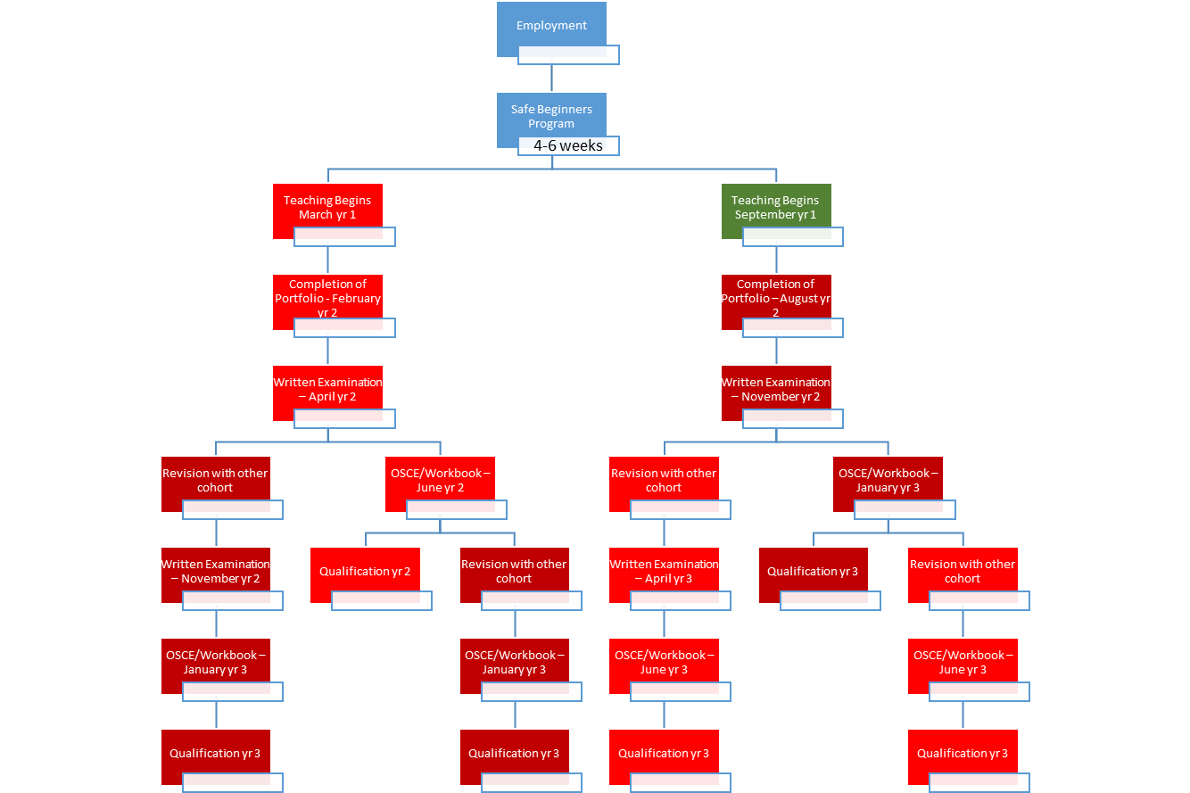
Learner Progression for a Two Cohort System

Slide 8
Similar Schemes
Cadet-ship established in Oldham in 2006
Preceptorship for newly-qualified general nurses

Slide 9
Sources of Funding
GDS, CDS, HDS and Specialist Practice pay for membership of the scheme
BCUHB
Welsh Government
Local Dental Committee

Slide 10
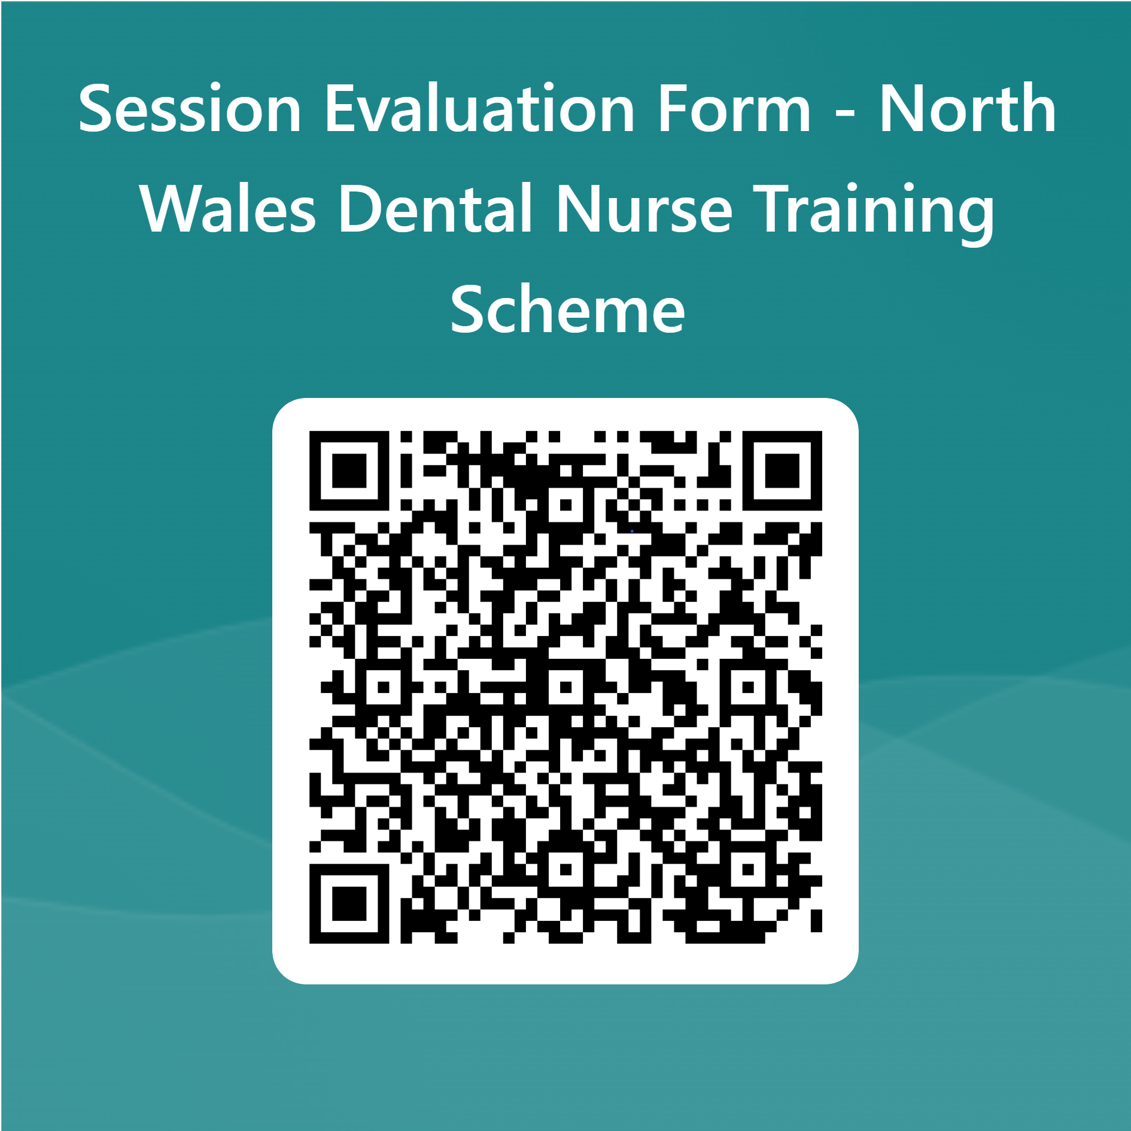

Slide 11
Thank you for your time.
We’re open for questions and discussion…

